Slide 1
HUMAN COMPUTER INTERACTION
Section: A
Assignment #2

Slide 2

Assignment on:
Human Errors:
Slips that occur in our life
Submitted by:
SADMAN SALIM NIPUN
ID: 20-44345-3
Submitted to:
DR. KHANDAKER TABIN HASAN

Slide 3

What is Slip?
Slip refers to a type of error that occurs when
a user intends to perform a certain action, but
accidentally performs a different action. Slip
errors are typically the result of a user’s
physical or cognitive limitations.

Slide 4

Type of Slips
We can place slips into one of six categories:
1. Capture errors
2. Description errors
3. Data-driven errors
4. Associative activation errors
5. Loss-of-activation errors
6. Mode errors
Among all those, five slips are going to be described.

Slide 5

Slip #1
Capture errors
Capture error refers to a type of error that occurs when a user unintentionally performs an action that was intended for a different target which is visually or functionally similar to the incorrect one.
Example:
Once I was coding C++ in my laptop. Suddenly a message popped up in my phone and while giving reply, I wrote some syntax of that language. That is capture error.

Slide 6

Slip #2
Data-driven errors
Data-driven error refers to a type of slip error that occurs when a user unintentionally performs an action that is similar to a correct action, but with different data.
Example:
Sometimes when someone asks me my phone number, I utter my university Id instead. This happens because I am used to dealing with my id no. in daily life. This is a data-driven error.

Slide 7

Slip #3
Associative activation errors
Associative activation error refers to a type of error that occurs when a user intends to select one item or action but ends up selecting a different one that is visually or conceptually similar due to automatic and unconscious activation of associated concepts in memory.
Example:
I used to send email on daily basis. But sometimes I click on the send button without mentioning the recipient. This is associative activation error.

Slide 8

Slip #4
Loss of activation errors
Loss of activation error refers to a type of error that occurs when a user forgets to perform a required action, such as clicking a button or entering information, because their attention has shifted away from the task at hand.
Example:
Once I switched my laptop on to submit my assignment and my father asked me at the same time. Afterwards, I couldn’t remember why I did turn it on. That is associative activation error.

Slide 9
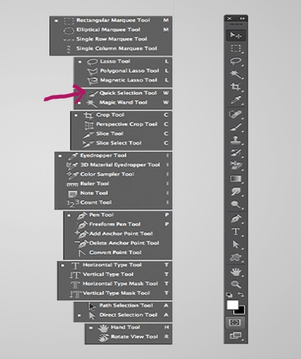
Slip #5
Selection Tool
Mode errors
Mode error refers to a type of error that occurs when a user unintentionally enters data or performs actions in the wrong mode or state of a system.
Example:
While using graphics editing software, I click and drag selection tool over an area to select it. To use the brush tool, I also need to click and drag to paint on the canvas. Before using this as brush tool, I forget to deselect it. As a result, it doesn't work while painting with brush tool. This is mode error.

Slide 10
THANK YOU

